Slide 1
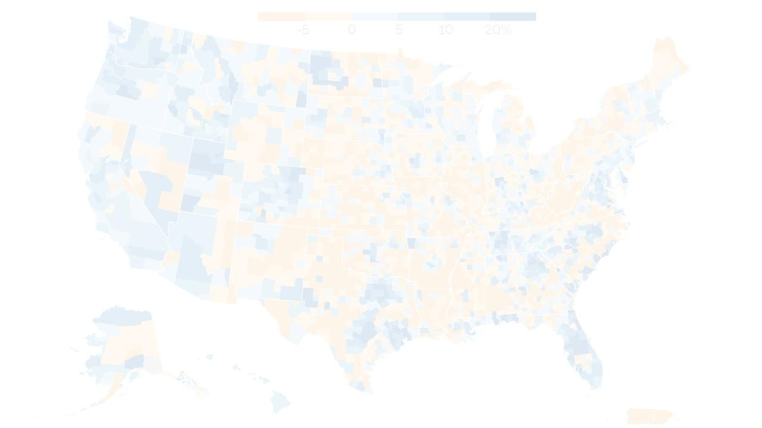
BISFG Final Presentation
Sander O’Neil
Wilson Macias

Slide 2
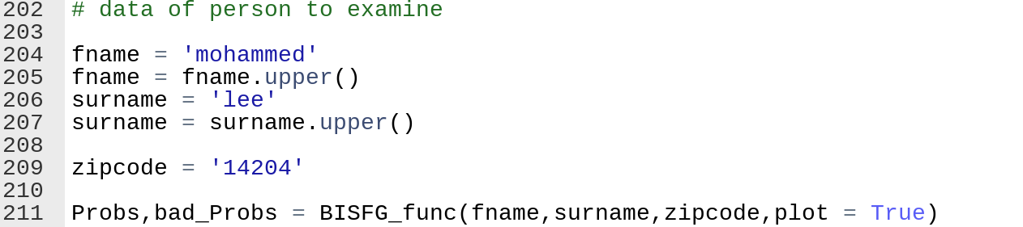
Try it Yourself
Go to https://github.com/Sander-ONeil/BISG
Download all files Run BISFG.py (may need to install python libraries) Edit bottom of file

Slide 3
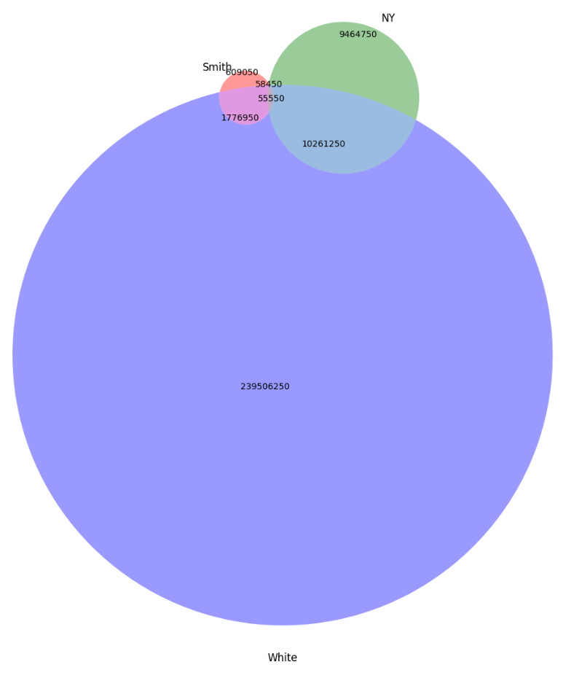
The algorithm essentially attempts to find the ratio between these two values for each race
Given:
The size of each of these circles,
The total population,
and the racial makeup of the name and location

Slide 4
Name
We know:
A+B+D+E = Name Pop
B+C+E+F = Loc pop
D+E+F+G = Race pop
A+B+C+D+E+F+G+H = total US population
(D+E) / (A+B+D+E) = Name racial %
(E+F) / (B+C+E+F) = Loc racial %
(D+E+F+G)/(A+B+C+D+E+F+G+H) = racial %
A
Location
B
C
E
H
D
F
G
We want to know:
E/(B+E)
actually we want to know
(E for each race) / (E for all races)
Binary vs Multi-class classification
Race

Slide 5
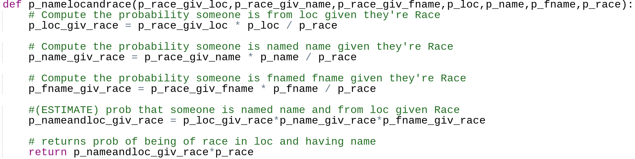
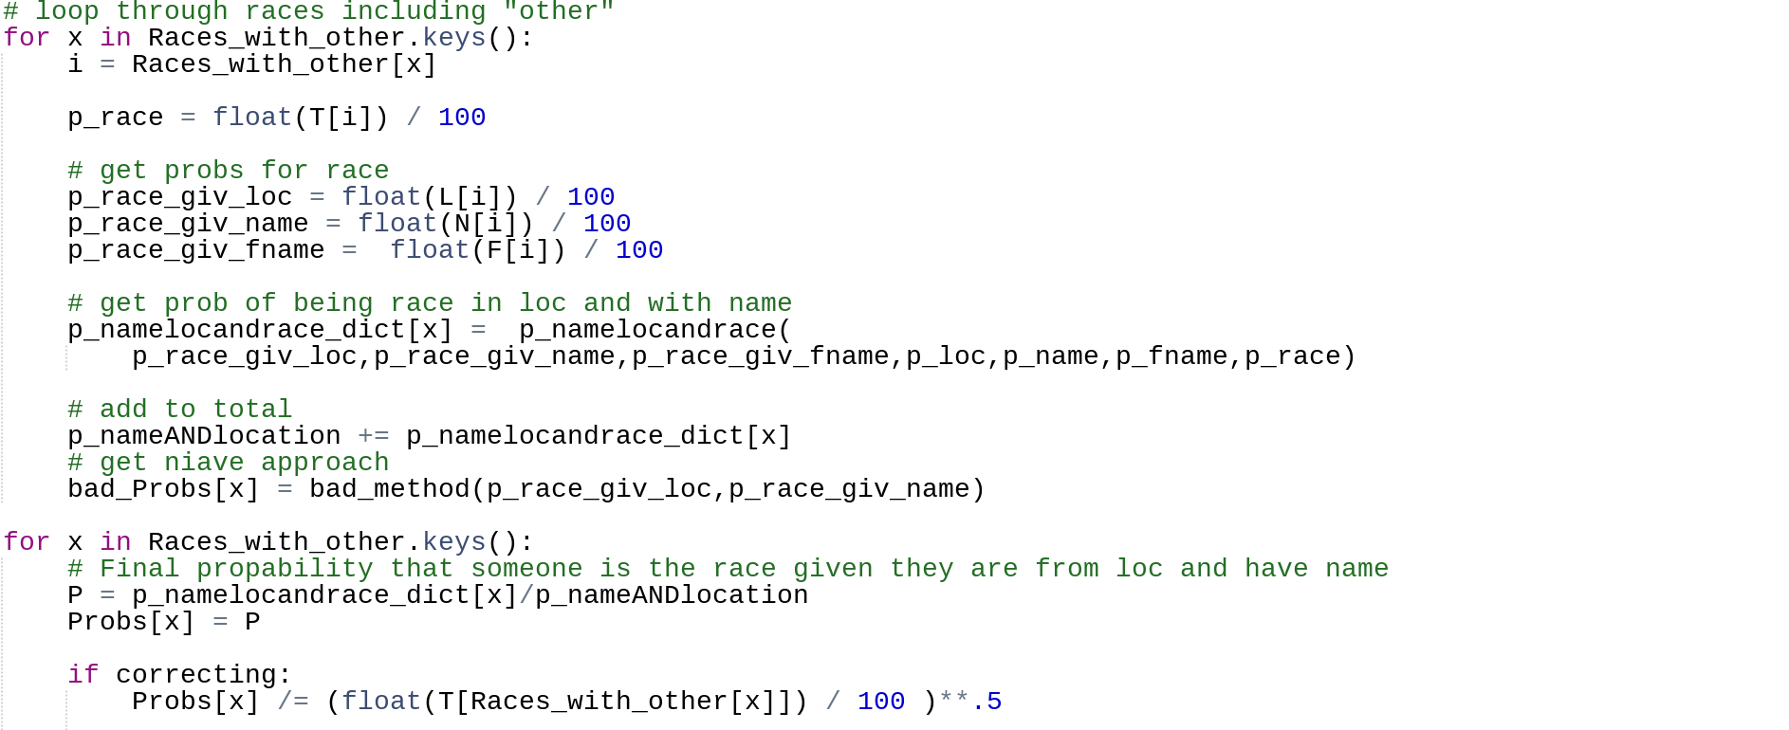
Bayes Law
Generates E from last slide
Adds E from all
Divide by total

Slide 6
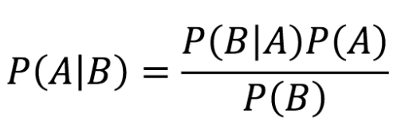
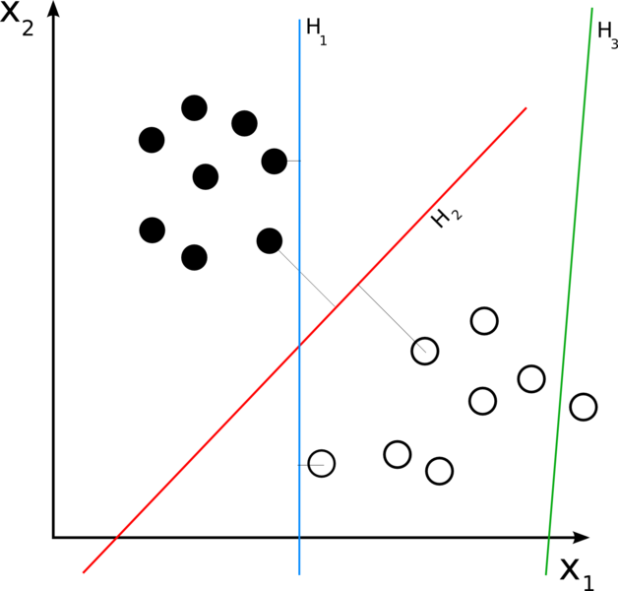
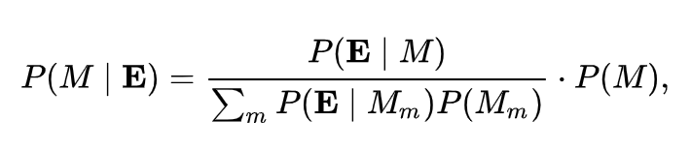
Bayes Law
Not a simple linear classifier
Bayesian Inference

Slide 7
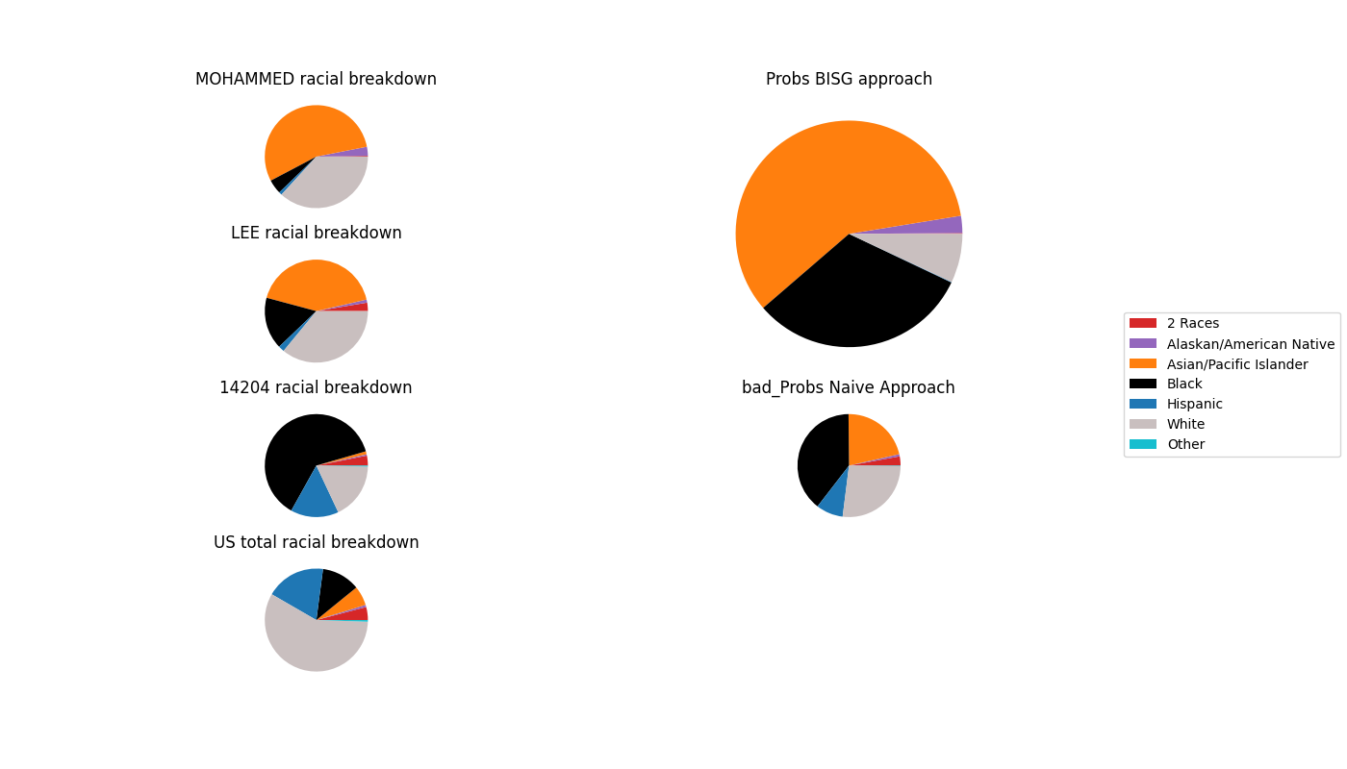

Slide 8
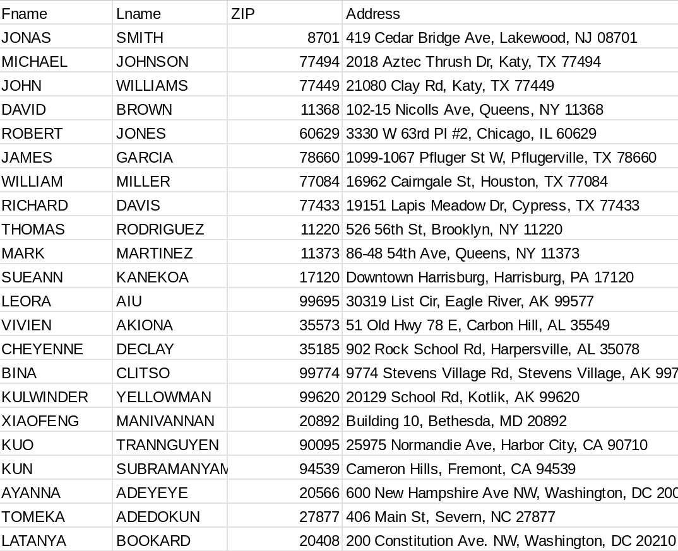
The Test Dataset

Slide 9
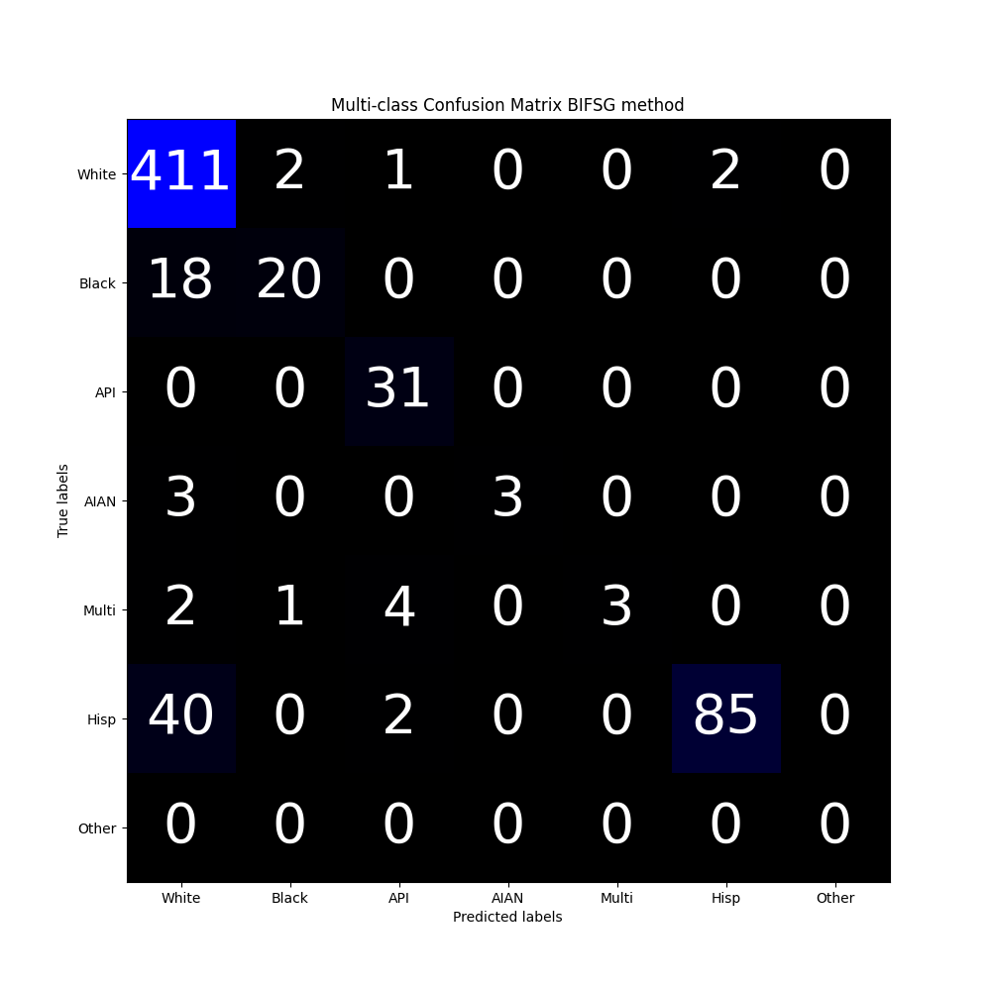
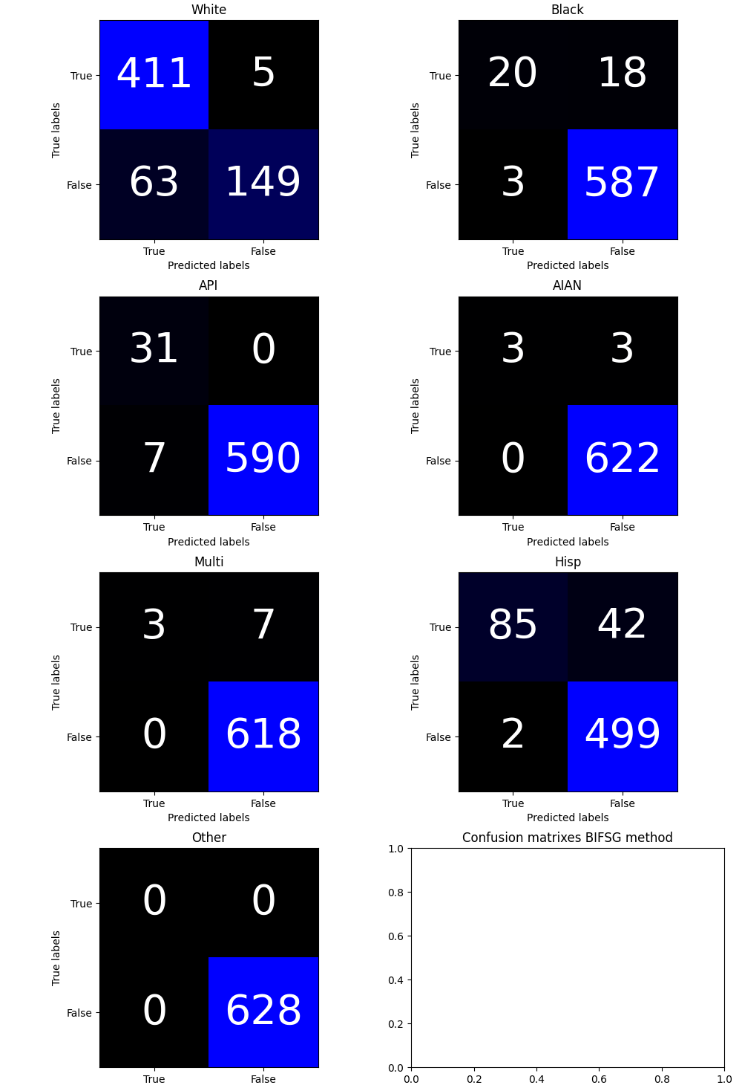
Confusion matrix for Algorithm

Slide 10
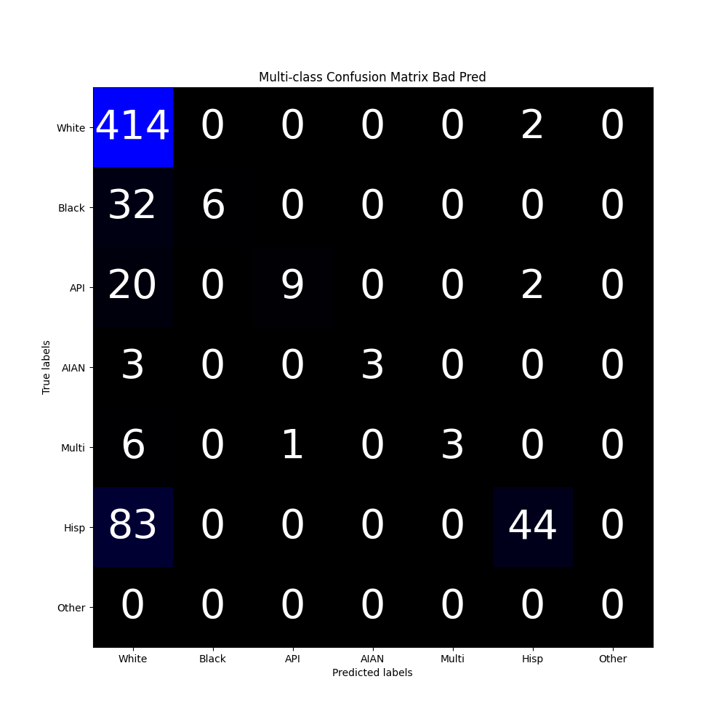
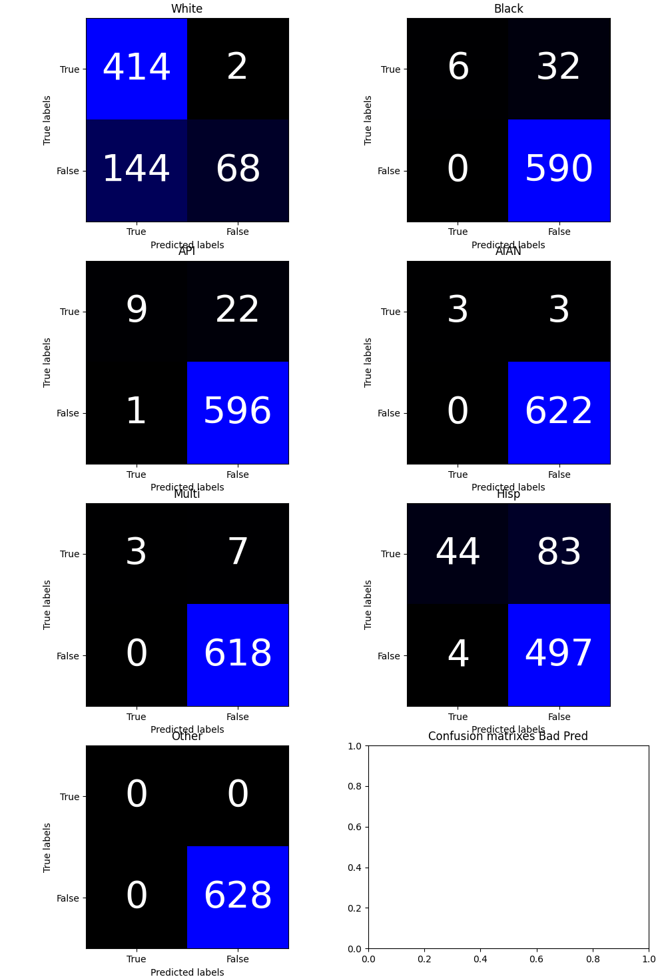
“Bad” method

Slide 11
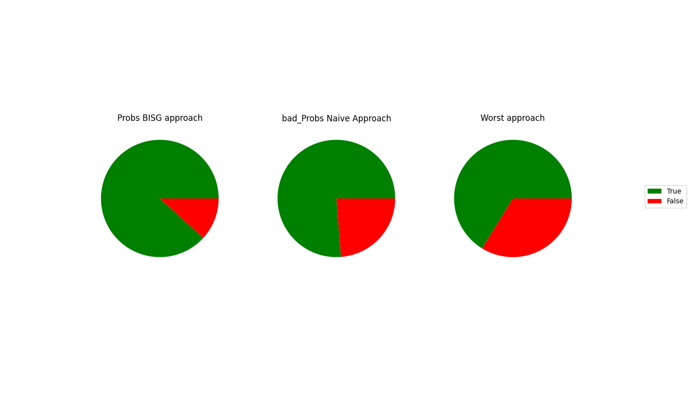
Rate of Correct Identifications
Prediction Accuracy:
88%
76%
66%
Naive approach: assuming the probability of race is the average of prior probabilities
Worst approach: assuming everyone is white

Slide 12
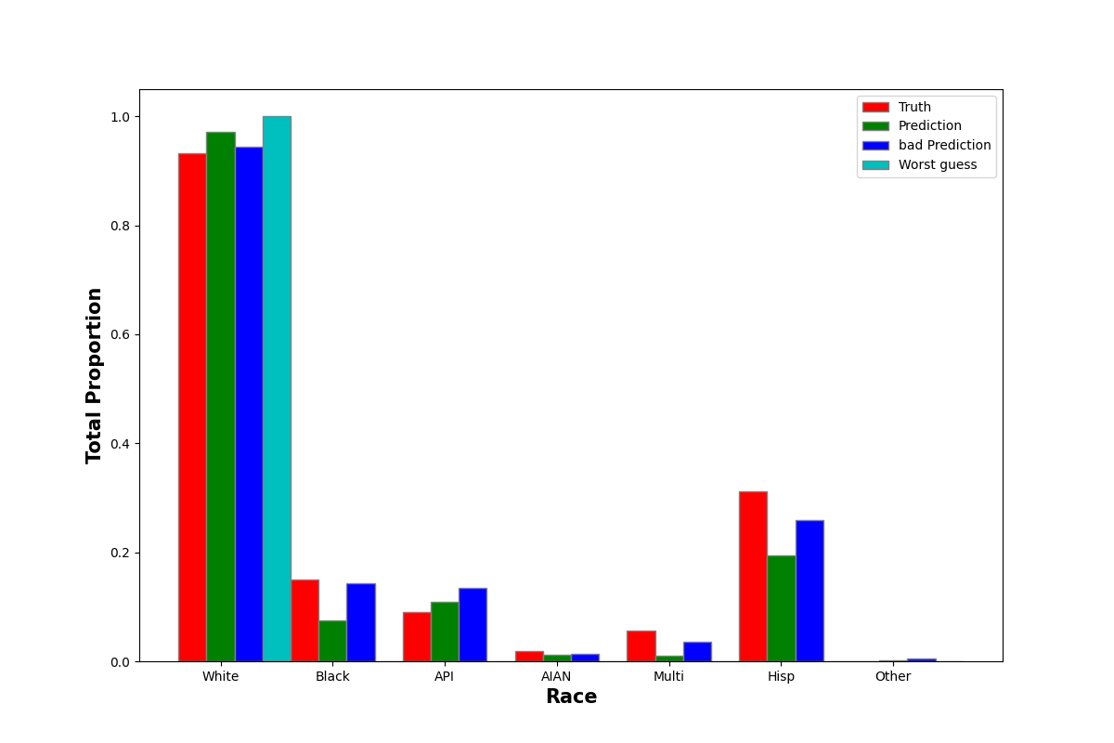
Proportion Prediction (sum of probabilities, not discrete)

Slide 13
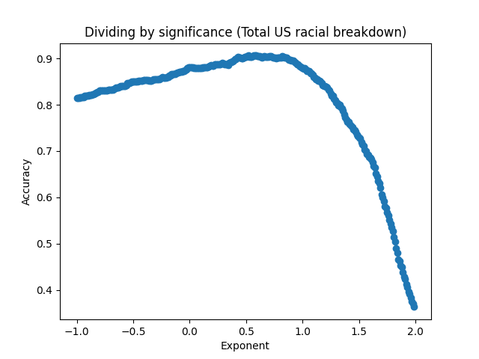
Possible correction criteria?
Boosts accuracy up to 90% (on test data)

Slide 14
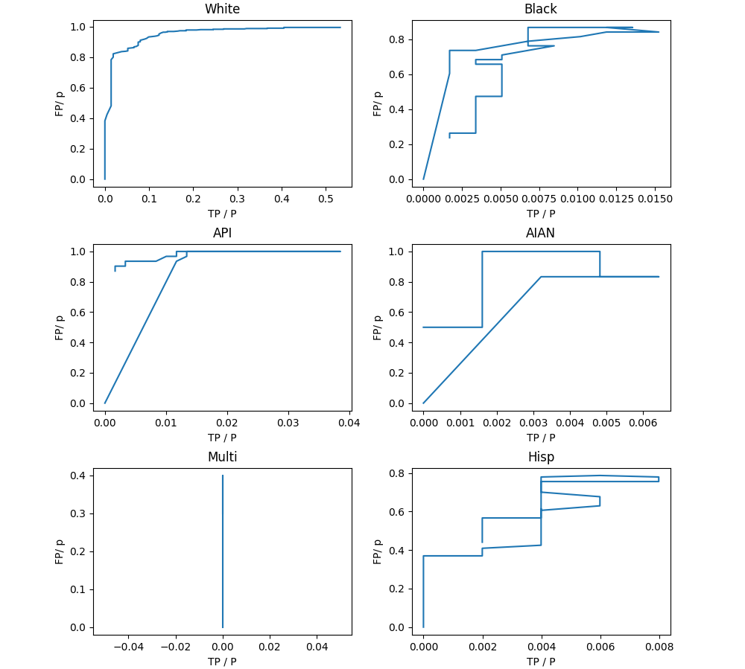
ROC Curves
For Correction Factor

Slide 15
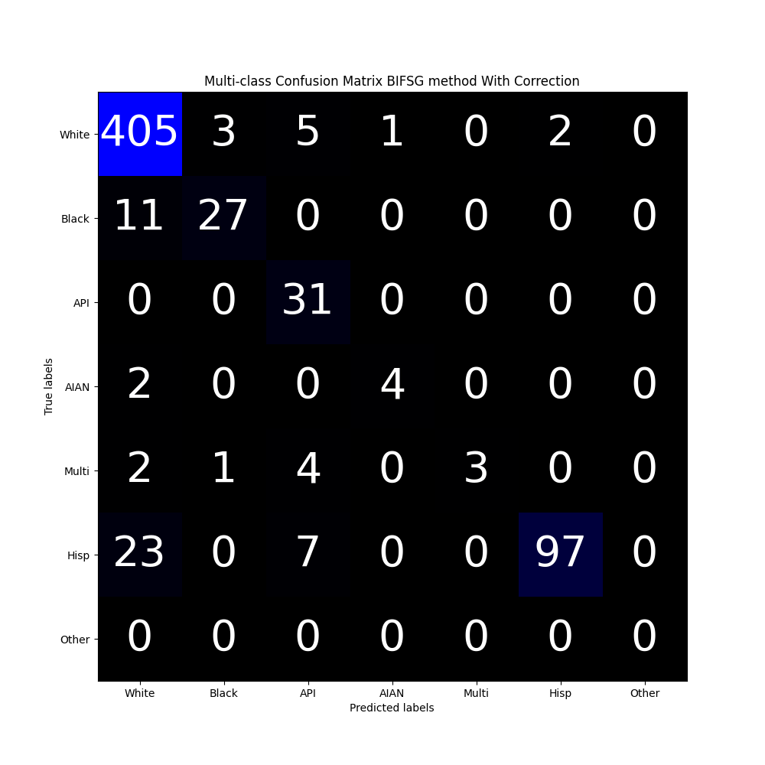
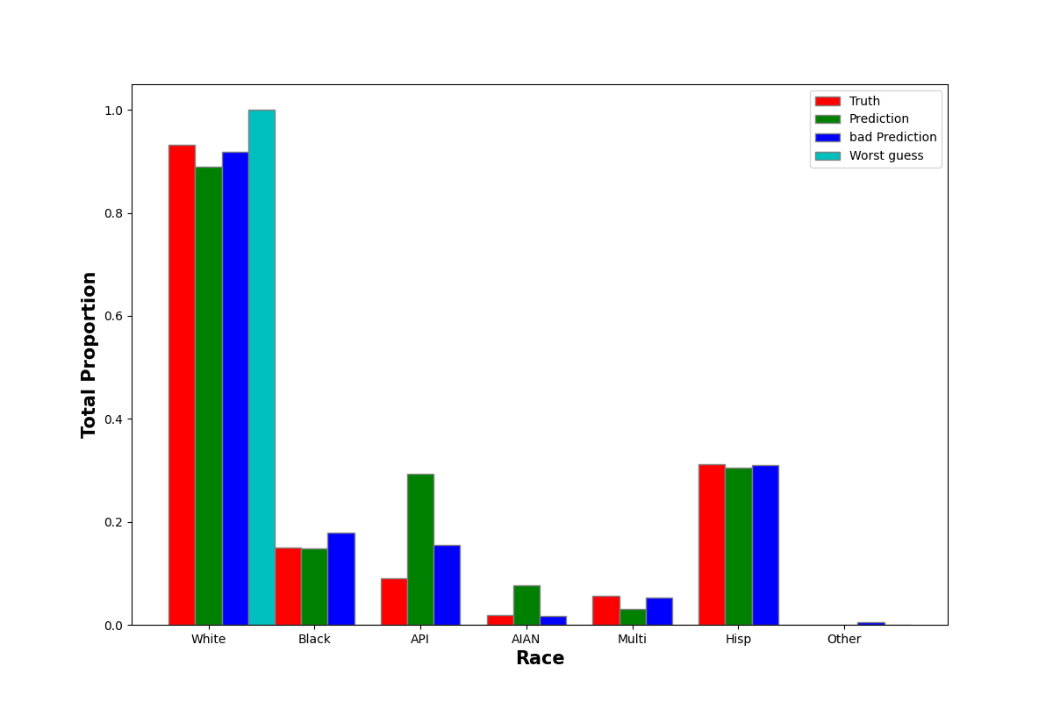
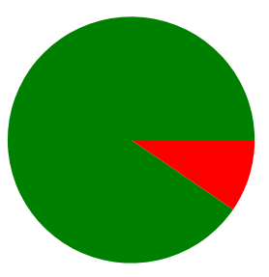
Metrics re -run After correction
90.4% prediction accuracy

